Slide 1




Open/Closed and Liskov Principles
Java OOP
Advanced
SoftUni Team
Technical Trainers
Software University
http://softuni.bg

Slide 2

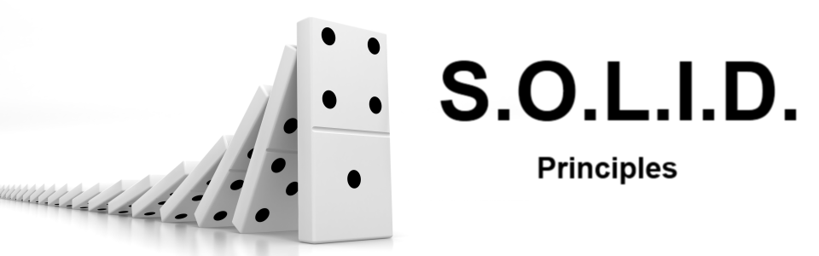
Table of Contents
OCP – Open / Closed Principle
Violations of OCP
LSP – Liskov Substitution Principle
Violations of LSP
<number>
Notes:
*
(c) 2007 National Academy for Software Development - http://academy.devbg.org. All rights reserved. Unauthorized copying or re-distribution is strictly prohibited.*
<number>##

Slide 3
Questions
sli.do #java-fund
<number>

Slide 4
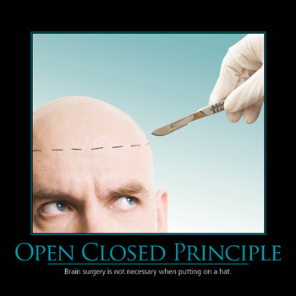
Open/Closed Principle
<number>
Notes:
© Software University Foundation – http://softuni.org
This work is licensed under the Creative Commons Attribution-NonCommercial-ShareAlike license.
<number>

Slide 5
What is Open/Closed?
„Software entities like classes, modules and functions should be open for extension but closed for modifications“
<number>

Slide 6

Extensibility
Implementation takes future growth into consideration
Extensible system is one whose internal structure and data flow are minimally or not affected by new or modified functionality
<number>
Notes:
In software engineering, extensibility (not to be confused with forward compatibility) is a systems design principle where the implementation takes future growth into consideration. It is a systemic measure of the ability to extend a system and the level of effort required to implement the extension. Extensions can be through the addition of new functionality or through modification of existing functionality. The central theme is to provide for change – typically enhancements – while minimizing impact to existing system functions.
Extensibility is a software design principle defined as a system’s ability to have new functionality extended, in which the system’s internal structure and data flow are minimally or not affected, particularly that recompiling or changing the original source code is unnecessary when changing a system’s behavior, either by the creator or other programmers.^{[1]} Because software systems are long lived and will be modified for new features and added functionalities demanded by users, extensibility enables developers to expand or add to the software’s capabilities and facilitates systematic reuse. Some of its approaches include facilities for allowing users’ own program routines to be inserted and the abilities to define new data types as well as to define new formatting markup tags.^{[2]}
© Software University Foundation – http://softuni.org
This work is licensed under the Creative Commons Attribution-NonCommercial-ShareAlike license.
<number>

Slide 7

Reusability
Software reusability more specifically refers to design features of a software element that enhance its suitability for reuse
Modularity
Low coupling
High cohesion
<number>
Notes:
Extensibility and reusability have many emphasized properties in common, including low coupling, modularity and high cohesion. Software reusability is boosted by extensibility and refers to software elements’ ability to construct for many different software systems, which is motivated by the observation of software systems often sharing common elements. Reusability together with extensibility allows a technology to be transferred to another project with less development and maintenance time, as well as enhanced reliability and consistency.^{[7]}
© Software University Foundation – http://softuni.org
This work is licensed under the Creative Commons Attribution-NonCommercial-ShareAlike license.
<number>

Slide 8
Problem: Extend ArrayList<T>
Create a class ExtendedArrayList<T>, which extends ArrayList<T> with two methods:
max()
min()
Try to modify ArrayList<T>
<<Iterator<Book>>>
ArrayList
ExtendedArrayList<T>
+max(): T
+min(): T
<number>
Notes:
© Software University Foundation – http://softuni.org
This work is licensed under the Creative Commons Attribution-NonCommercial-ShareAlike license.
<number>

Slide 9
Solution: Extend ArrayList<T>
public class ExtendedArrayList<T extends Comparable<T>> extends ArrayList<T> {
public T max() {
TODO: Add buisnes logic for finding max element
}
public T min() {
TODO: Add buisnes logic for finding min element
}
}
<number>
Notes:
There are two ways to achieve abstraction
- Using Abstract Classes
- Using Interfaces
© Software University Foundation – http://softuni.org
This work is licensed under the Creative Commons Attribution-NonCommercial-ShareAlike license.
<number>

Slide 10
Open/Closed Principle (OCP)
Design and writing of the code should be done in a way that new functionality should be added with minimum changes in the existing code
Changes to source code are not required
<number>
Notes:
Extensibility and reusability have many emphasized properties in common, including low coupling, modularity and high cohesion. Software reusability is boosted by extensibility and refers to software elements’ ability to construct for many different software systems, which is motivated by the observation of software systems often sharing common elements. Reusability together with extensibility allows a technology to be transferred to another project with less development and maintenance time, as well as enhanced reliability and consistency.^{[7]}
© Software University Foundation – http://softuni.org
This work is licensed under the Creative Commons Attribution-NonCommercial-ShareAlike license.
<number>

Slide 11
Problem: Stream Progress Info
Refactor skeleton given for this problem:
StreamProgressInfo class must work with Music class too
Be sure if you add new class which provide getBytesSent() and getLength() will work without touching StreamProgressInfo
<number>
Notes:
© Software University Foundation – http://softuni.org
This work is licensed under the Creative Commons Attribution-NonCommercial-ShareAlike license.
<number>

Slide 12
Solution: Stream Progress Info
public class StreamProgressInfo {
private Streamable streamable;
public StreamProgressInfo(Streamable streamResult) {
this.streamable = streamResult;
}
public int calculateStreamProgress() {
return (this.streamable.getBytesSent() * 100) / this.streamable.getLength();
} }
<number>
Notes:
There are two ways to achieve abstraction
- Using Abstract Classes
- Using Interfaces
© Software University Foundation – http://softuni.org
This work is licensed under the Creative Commons Attribution-NonCommercial-ShareAlike license.
<number>

Slide 13
Solution: Stream Progress Info (2)
public interface Streamable {
int getLength();
int getBytesSent();
}
public class File implements Streamable {
//TODO: Add business logic
}
public class Music implements Streamable {
//TODO: Add business logic
}
<number>
Notes:
There are two ways to achieve abstraction
- Using Abstract Classes
- Using Interfaces
© Software University Foundation – http://softuni.org
This work is licensed under the Creative Commons Attribution-NonCommercial-ShareAlike license.
<number>

Slide 14


OCP – Violations
Cascading changes through modules
Each change requires re-testing
Logic depends on conditional statements
<number>
Notes:
Extensibility and reusability have many emphasized properties in common, including low coupling, modularity and high cohesion. Software reusability is boosted by extensibility and refers to software elements’ ability to construct for many different software systems, which is motivated by the observation of software systems often sharing common elements. Reusability together with extensibility allows a technology to be transferred to another project with less development and maintenance time, as well as enhanced reliability and consistency.^{[7]}
© Software University Foundation – http://softuni.org
This work is licensed under the Creative Commons Attribution-NonCommercial-ShareAlike license.
<number>

Slide 15
Problem: Graphic Editor
Refactor skeleton given for this task so
GraphicEditor class draw all kind of shapes without asking what kind of shape we pass
Be sure if you add new type of shape system will work correctly without touching GraphicEditor
<number>
Notes:
© Software University Foundation – http://softuni.org
This work is licensed under the Creative Commons Attribution-NonCommercial-ShareAlike license.
<number>

Slide 16
Solution: Graphic Editor(1)
public class GraphicEditor {
void drawShape(Shape shape) {
shape.draw();
}
}
public interface Shape {
void draw();
}
<number>
Notes:
There are two ways to achieve abstraction
- Using Abstract Classes
- Using Interfaces
© Software University Foundation – http://softuni.org
This work is licensed under the Creative Commons Attribution-NonCommercial-ShareAlike license.
<number>

Slide 17
Solution: Graphic Editor(2)
class Rectangle extends Shape {
public void draw() {
System.out.println("I'm Rectangle");
}
}
//TODO: Make the same for Circle
<number>
Notes:
There are two ways to achieve abstraction
- Using Abstract Classes
- Using Interfaces
© Software University Foundation – http://softuni.org
This work is licensed under the Creative Commons Attribution-NonCommercial-ShareAlike license.
<number>

Slide 18

OCP – Solutions
Inheritance / Abstraction
Inheritance / Template Method pattern
Composition / Strategy patterns
<number>
Notes:
Extensibility and reusability have many emphasized properties in common, including low coupling, modularity and high cohesion. Software reusability is boosted by extensibility and refers to software elements’ ability to construct for many different software systems, which is motivated by the observation of software systems often sharing common elements. Reusability together with extensibility allows a technology to be transferred to another project with less development and maintenance time, as well as enhanced reliability and consistency.^{[7]}
© Software University Foundation – http://softuni.org
This work is licensed under the Creative Commons Attribution-NonCommercial-ShareAlike license.
<number>

Slide 19

Open/Closed Principle
Live Exercises in Class (Lab)
Notes:
<number>
© Software University Foundation – http://softuni.org
This work is licensed under the Creative Commons Attribution-NonCommercial-ShareAlike license.

Slide 20
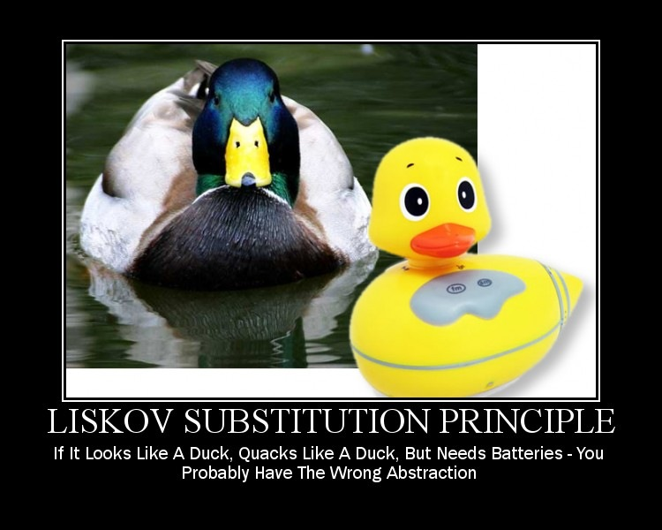
Liskov Substitution Principle
<number>
Notes:
© Software University Foundation – http://softuni.org
This work is licensed under the Creative Commons Attribution-NonCommercial-ShareAlike license.
<number>

Slide 21
What is Liskov Substitution?
“Derived types must be completely substitutable for their base types”
<number>

Slide 22
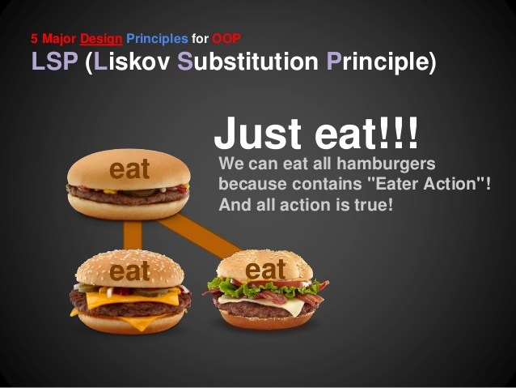
Liskov Substitution Principle (LSP)
Reference to the base class can be replaced with a derived class without affecting the functionality of the program module
Derived classes just extend without replacing the functionality of old classes
<number>
Notes:
Substitutability is a principle in object-oriented programming that states that, in a computer program, if S is a subtype of T, then objects of type T may be replaced with objects of type S (i.e., an object of the type T may be substituted with its subtype object of the type S) without altering any of the desirable properties of that program (correctness, task performed, etc.).
© Software University Foundation – http://softuni.org
This work is licensed under the Creative Commons Attribution-NonCommercial-ShareAlike license.
<number>

Slide 23
Problem: Detail Printer
Refactor skeleton given for this task so
DetailPrinter class print correctly any kind of employee, which is in collection
Remove any instanceof from your code
Be sure if you add new type of employee system will work correctly without touching DetailPrinter
<number>
Notes:
© Software University Foundation – http://softuni.org
This work is licensed under the Creative Commons Attribution-NonCommercial-ShareAlike license.
<number>

Slide 24
Solution: Detail Printer
public class Employee {
private String name;
public Employee(String name) {
this.name = name;
}
@Override
public String toString() {
return "Name: " + this.name;
} }
<number>
Notes:
There are two ways to achieve abstraction
- Using Abstract Classes
- Using Interfaces
© Software University Foundation – http://softuni.org
This work is licensed under the Creative Commons Attribution-NonCommercial-ShareAlike license.
<number>

Slide 25
Solution: Detail Printer (2)
public class Manager extends Employee {
private Iterable<String> docs;
public Manager(String name, Iterable<String> docs) {
super(name);
this.documents = docs;
}
public String toString() {
return super.toString() + "Documents: " + this.docs;
} }
<number>
Notes:
There are two ways to achieve abstraction
- Using Abstract Classes
- Using Interfaces
© Software University Foundation – http://softuni.org
This work is licensed under the Creative Commons Attribution-NonCommercial-ShareAlike license.
<number>

Slide 26
Solution: Detail Printer (3)
public class DetailsPrinter {
private Iterable<Employee> employees;
public DetailsPrinter(Iterable<Employee> employees) {
this.employees = employees;
}
public void printEmployees() {
for(Employee e : employees) {
System.out.println(e.toString());
} } }
<number>
Notes:
There are two ways to achieve abstraction
- Using Abstract Classes
- Using Interfaces
© Software University Foundation – http://softuni.org
This work is licensed under the Creative Commons Attribution-NonCommercial-ShareAlike license.
<number>

Slide 27
LSP Relationship
OOP Inheritance
Plus LSP
Student IS-A Person
Student IS-SUBSTITUTED-FOR Person
<number>
Notes:
E.g. Animal is substitutable for Dog
© Software University Foundation – http://softuni.org
This work is licensed under the Creative Commons Attribution-NonCommercial-ShareAlike license.
<number>

Slide 28
OCP vs LSP
“Liskov Substitution Principle is just an extension of the Open Close Principle and it means that we must make sure that new derived classes are extending the base classes without changing their behavior.”
<number>
Notes:
E.g. Animal is substitutable for Dog
© Software University Foundation – http://softuni.org
This work is licensed under the Creative Commons Attribution-NonCommercial-ShareAlike license.
<number>

Slide 29
LSP – Violations
Type Checking
Overridden methods say "I am not implemented"
Base class depends on its subtypes
<number>
Notes:
Extensibility and reusability have many emphasized properties in common, including low coupling, modularity and high cohesion. Software reusability is boosted by extensibility and refers to software elements’ ability to construct for many different software systems, which is motivated by the observation of software systems often sharing common elements. Reusability together with extensibility allows a technology to be transferred to another project with less development and maintenance time, as well as enhanced reliability and consistency.^{[7]}
© Software University Foundation – http://softuni.org
This work is licensed under the Creative Commons Attribution-NonCommercial-ShareAlike license.
<number>

Slide 30
Problem: Square
We know from Math that square is a rectangle
Look at the skeleton given for this task
Think how to refactor code so:
Square extends rectangle without producing bugs
Prepare new unit tests for Square after the refactoring
<number>
Notes:
© Software University Foundation – http://softuni.org
This work is licensed under the Creative Commons Attribution-NonCommercial-ShareAlike license.
<number>

Slide 31
LSP – Solutions
"Tell, Don't Ask"
Refactoring in the
base class
<number>
Notes:
Extensibility and reusability have many emphasized properties in common, including low coupling, modularity and high cohesion. Software reusability is boosted by extensibility and refers to software elements’ ability to construct for many different software systems, which is motivated by the observation of software systems often sharing common elements. Reusability together with extensibility allows a technology to be transferred to another project with less development and maintenance time, as well as enhanced reliability and consistency.^{[7]}
© Software University Foundation – http://softuni.org
This work is licensed under the Creative Commons Attribution-NonCommercial-ShareAlike license.
<number>

Slide 32
Liskov Substitution Principle
Live Exercises in Class (Lab)
Notes:
<number>
© Software University Foundation – http://softuni.org
This work is licensed under the Creative Commons Attribution-NonCommercial-ShareAlike license.

Slide 33
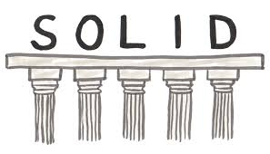
Summary
OCP – Open / Closed Principle
Violations of OCP
LSP – Liskov Substitution Principle
Violations of LSP
<number>

Slide 34
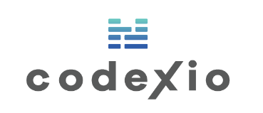











Java Advanced – Course Overview
https://softuni.bg/courses/java-oop-advanced
Notes:
© Software University Foundation – http://softuni.org
This work is licensed under the Creative Commons Attribution-NonCommercial-ShareAlike license.
<number>

Slide 35





Trainings @ Software University (SoftUni)
Software University – High-Quality Education, Profession and Job for Software Developers
softuni.bg
Software University Foundation
http://softuni.foundation/
Software University @ Facebook
facebook.com/SoftwareUniversity
Software University Forums
forum.softuni.bg
Notes:
© Software University Foundation – http://softuni.org
This work is licensed under the Creative Commons Attribution-NonCommercial-ShareAlike license.
<number>

Slide 36
License
This course (slides, examples, demos, videos, homework, etc.) is licensed under the "Creative Commons Attribution-NonCommercial-ShareAlike 4.0 International" license
Attribution: this work may contain portions from
"Fundamentals of Computer Programming with Java" book by Svetlin Nakov & Co. under CC-BY-SA license
" Thinking in Java 4th ed." book by Bruce Eckel, Copyright © 2006 by Bruce Eckel
"OOP" course by Telerik Academy under CC-BY-NC-SA license
<number>
Notes:
© Software University Foundation – http://softuni.org
This work is licensed under the Creative Commons Attribution-NonCommercial-ShareAlike license.
<number>

